Slide 1
Chapter 4: Threads & Concurrency
2024

Slide 2
Outline
Overview
Multicore Programming
Multithreading Models
Thread Libraries
Implicit Threading
Threading Issues
Operating System Examples

Slide 3
Objectives
Identify the basic components of a thread, and contrast threads and processes
Describe the benefits and challenges of designing multithreaded applications
Illustrate different approaches to implicit threading including thread pools, fork-join, and Grand Central Dispatch
Describe how the Windows and Linux operating systems represent threads
Design multithreaded applications using the Pthreads, Java, and Windows threading APIs

Slide 4
Motivation
Most modern applications are multithreaded
Threads run within application
Multiple tasks with the application can be implemented by separate threads
Update display
Fetch data
Spell checking
Answer a network request
Process creation is heavy-weight while thread creation is light-weight
Can simplify code, increase efficiency
Kernels are generally multithreaded

Slide 5
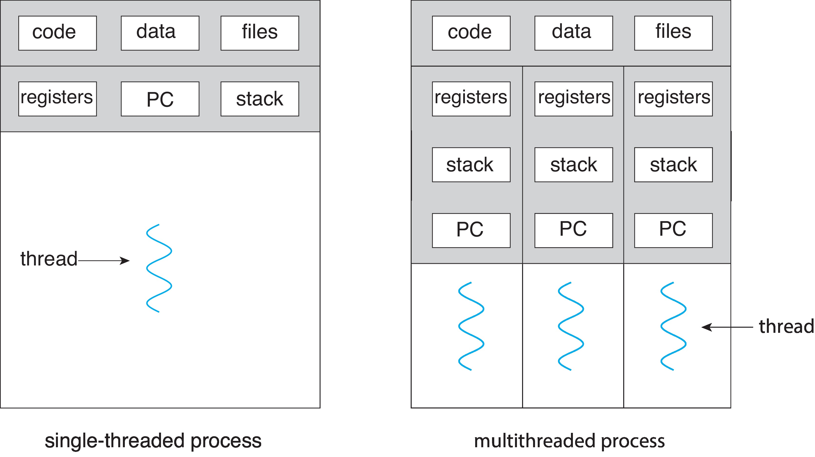
Single and Multithreaded Processes

Slide 6
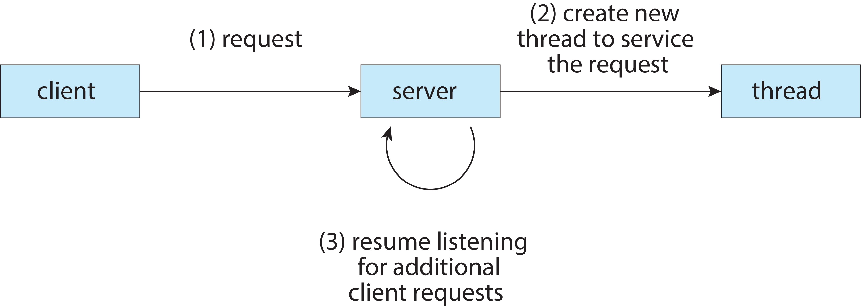
Multithreaded Server Architecture

Slide 7
Benefits
Responsiveness – may allow continued execution if part of process is blocked, especially important for user interfaces
Resource Sharing – threads share resources of process, easier than shared memory or message passing
Economy – cheaper than process creation, thread switching lower overhead than context switching
Scalability – process can take advantage of multicore architectures

Slide 8
Multicore Programming
Multicore or multiprocessor systems putting pressure on programmers, challenges include:
Dividing activities
Balance
Data splitting
Data dependency
Testing and debugging
Parallelism implies a system can perform more than one task simultaneously
Concurrency supports more than one task making progress
Single processor / core, scheduler providing concurrency

Slide 9
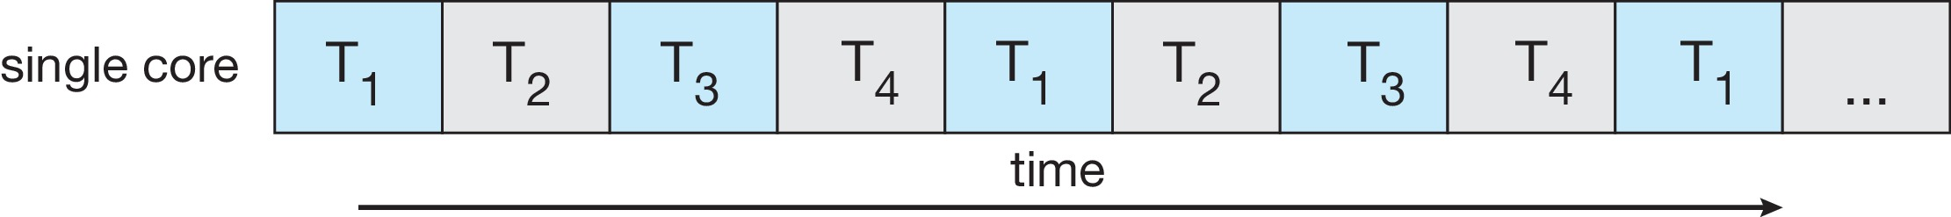
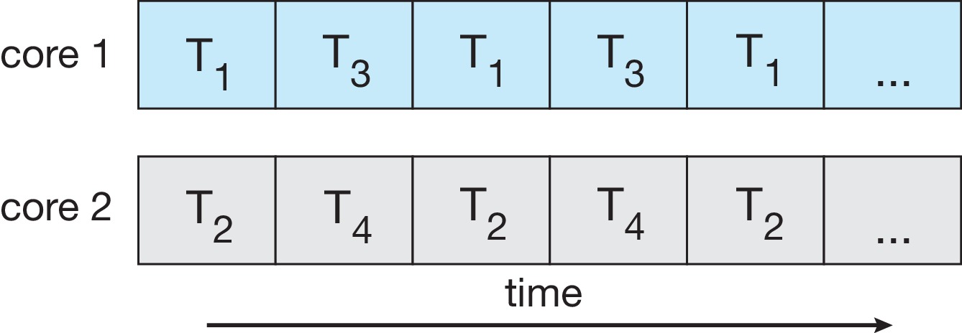
Concurrency vs. Parallelism
Concurrent execution on single-core system:
Parallelism on a multi-core system:

Slide 10
Multicore Programming
Types of parallelism
Data parallelism – distributes subsets of the same data across multiple cores, same operation on each
معالجة أجزاء البيانات بشكل متزامن مثل جمع مصفوفه على عدة اجهزه
Task parallelism – distributing threads across cores, each thread performing unique operation
تنفيذ اجزاء من البرنامج thread على عدة اجهزه

Slide 11
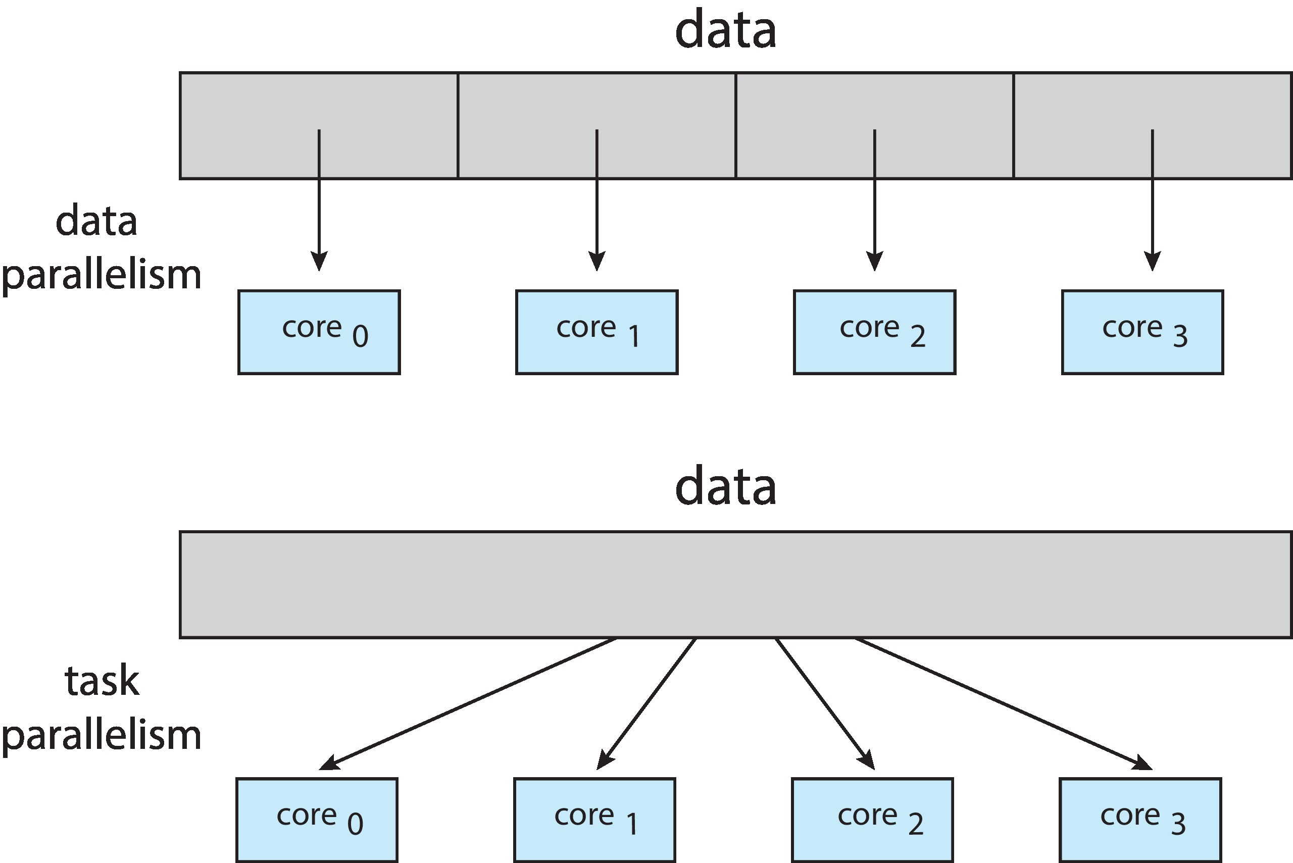
Data and Task Parallelism

Slide 12
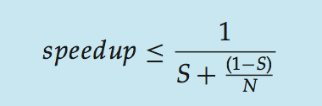
Amdahl’s Law
Identifies performance gains from adding additional cores to an application that has both serial and parallel components
S is serial portion
N processing cores
EXAMPLE, if application is 75% parallel / 25% serial, moving from 1 to 2 cores results in speedup of 1.6 times
1/(.25+(1-.25)/2)=1/.625= 1.6
As N approaches infinity, speedup approaches 1 / S
Serial portion of an application has disproportionate تاثير عكسي effect on performance gained by adding additional cores
But does the law take into account contemporary multicore systems? ولكن هل يأخذ القانون في الاعتبار الأنظمة المعاصرة متعددة النواة؟
Yes, it's still true
Notes:
Yes, it's still true. The speedup can't be less than zero (if parallelizing your code makes it slower, just run the serial version) or more than 100% (because saving more than 100% of the runtime would make the runtime negative).
Multicore processors are essentially just a matter of terminology changing over time. If you think you have one processor with four cores, Amdahl thinks you have four processors.

Slide 13
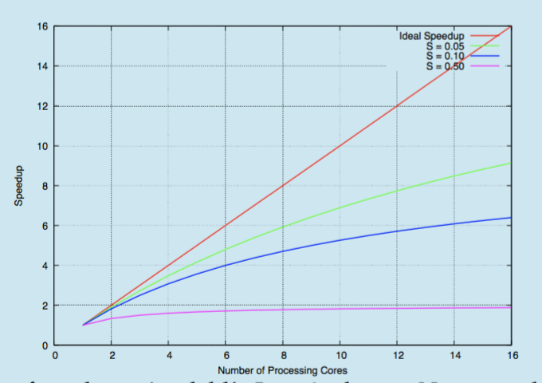
Amdahl’s Law
Notes:
RED IDEAL مثالي

Slide 14
Multithreading Models
Our discussion so far has treated threads in a generic sense. However, support for threads may be provided either at
the user level, for user threads, User threads are supported above the kernel and are managed without kernel support,
or by the kernel, for kernel threads. whereas kernel threads are supported and managed directly by the operating system.
Virtually all current operating systems—including Windows, Linux, and macOS— support kernel threads.

Slide 15
User Threads and Kernel Threads
User threads - management done by user-level threads library
Three primary thread libraries:
POSIX Pthreads
Windows threads
Java threads
Kernel threads - Supported by the Kernel
Examples – virtually all general -purpose operating systems, including:
Windows
Linux
Mac OS X
iOS
Android

Slide 16
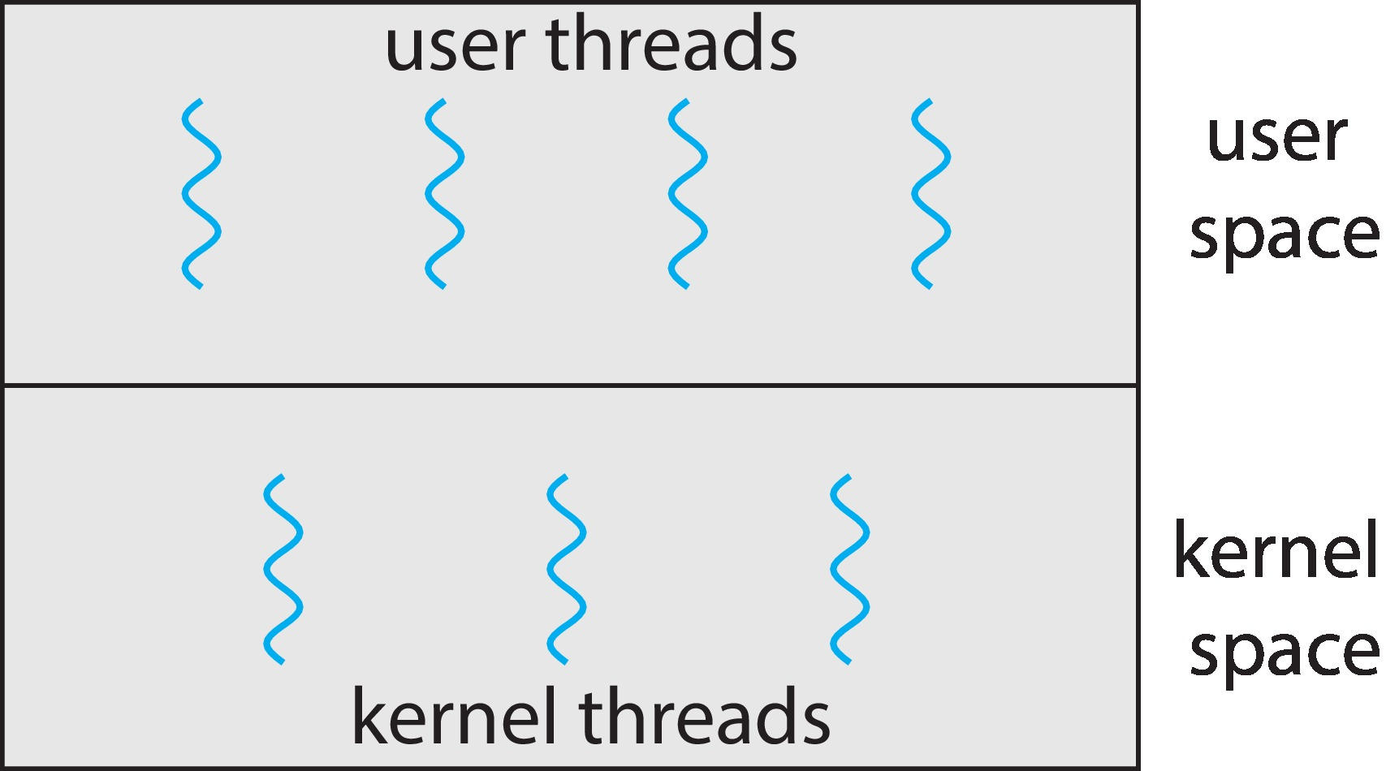
User and Kernel Threads

Slide 17
Multithreading Models
Many-to-One
One-to-One
Many-to-Many
Two level model

Slide 18
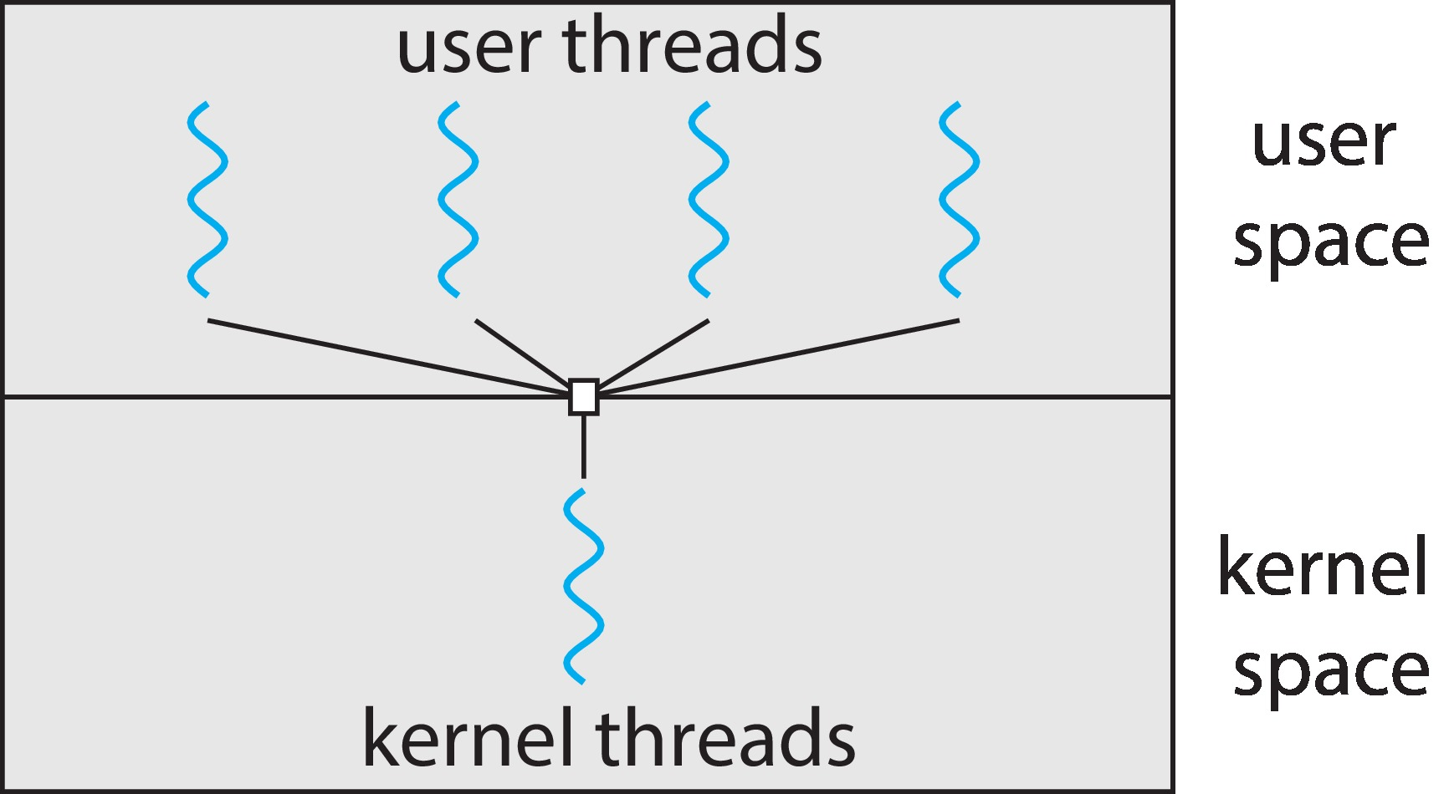
1.Many-to-One
Many user-level threads mapped to single kernel thread
One thread blocking causes all to block
Multiple threads may not run in parallel on multicores system because only one may be in kernel at a time
Few systems currently use this model
Examples:
Solaris Green Threads
GNU Portable Threads

Slide 19
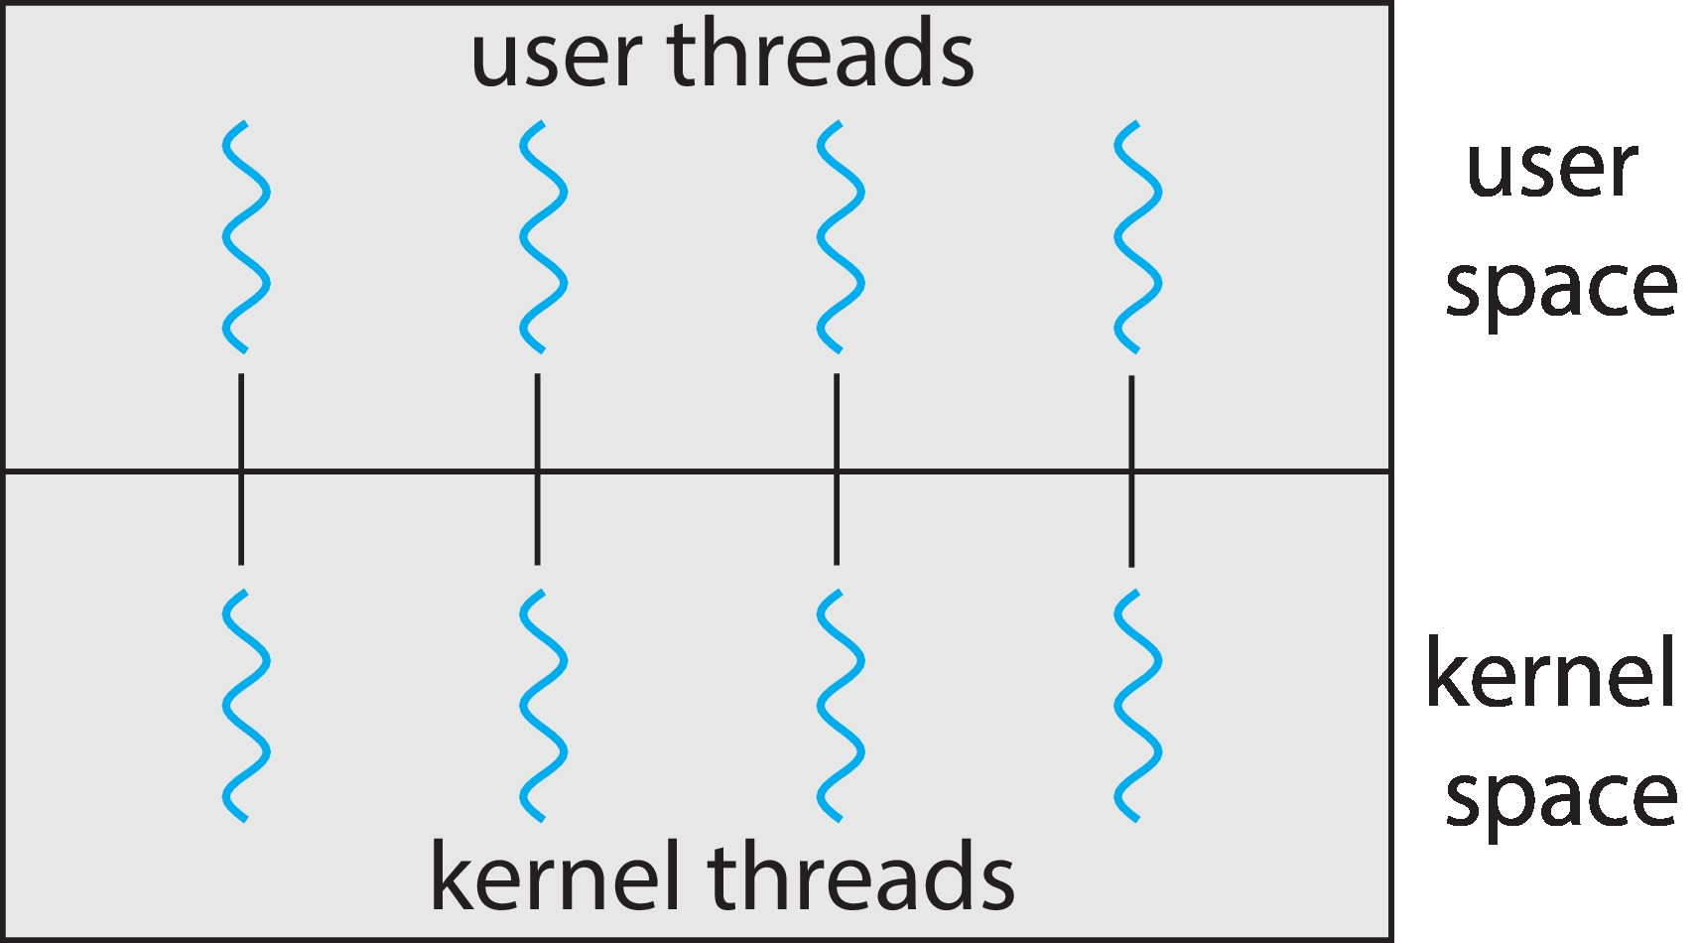
2.One-to-One
Each user-level thread maps to kernel thread
Creating a user-level thread creates a kernel thread
More concurrency than many-to-one
Number of threads per process sometimes restricted due to overhead عدد مؤشرات الترابط لكل عملية مقيد في بعض الأحيان بسبب الحمل
Examples
Windows
Linux

Slide 20
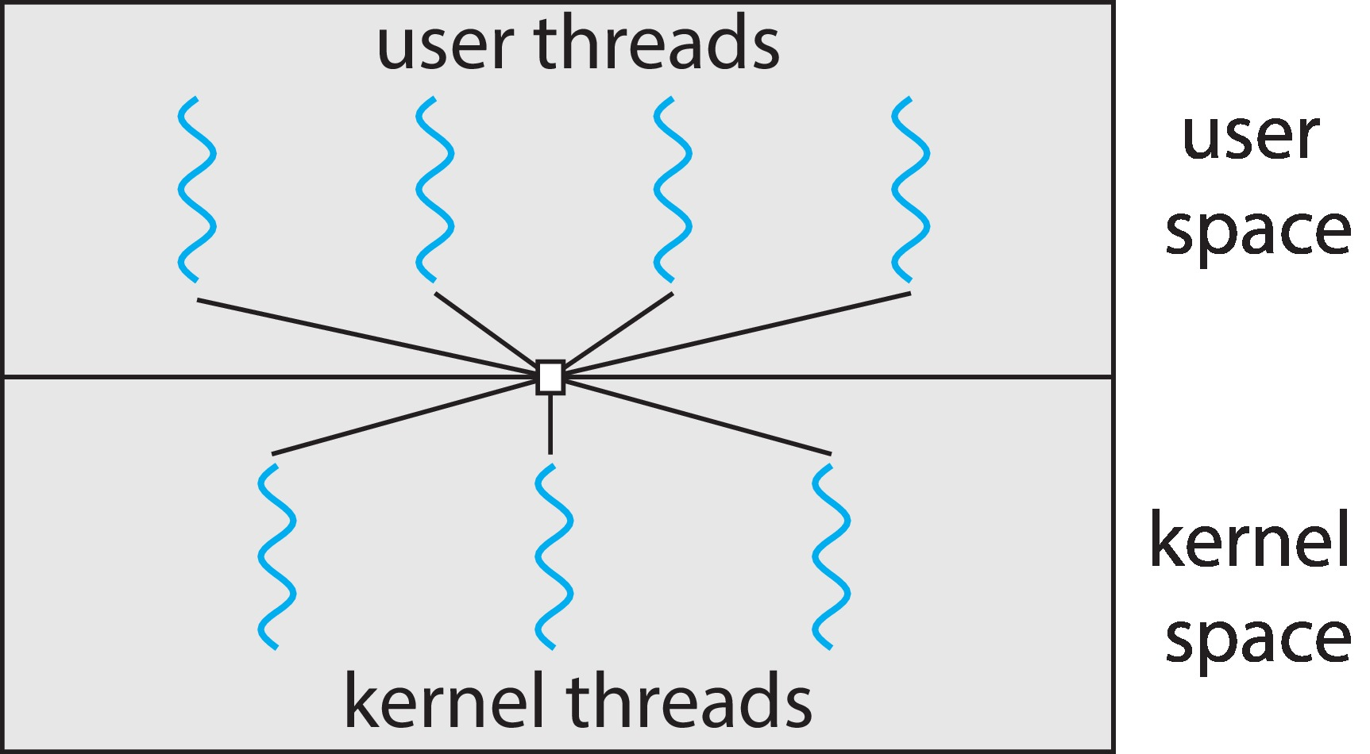
3.Many-to-Many Model
Allows many user level threads to be mapped to many kernel threads
Allows the operating system to create a sufficient number of kernel threads
Windows with the ThreadFiber package
Otherwise not very common

Slide 21
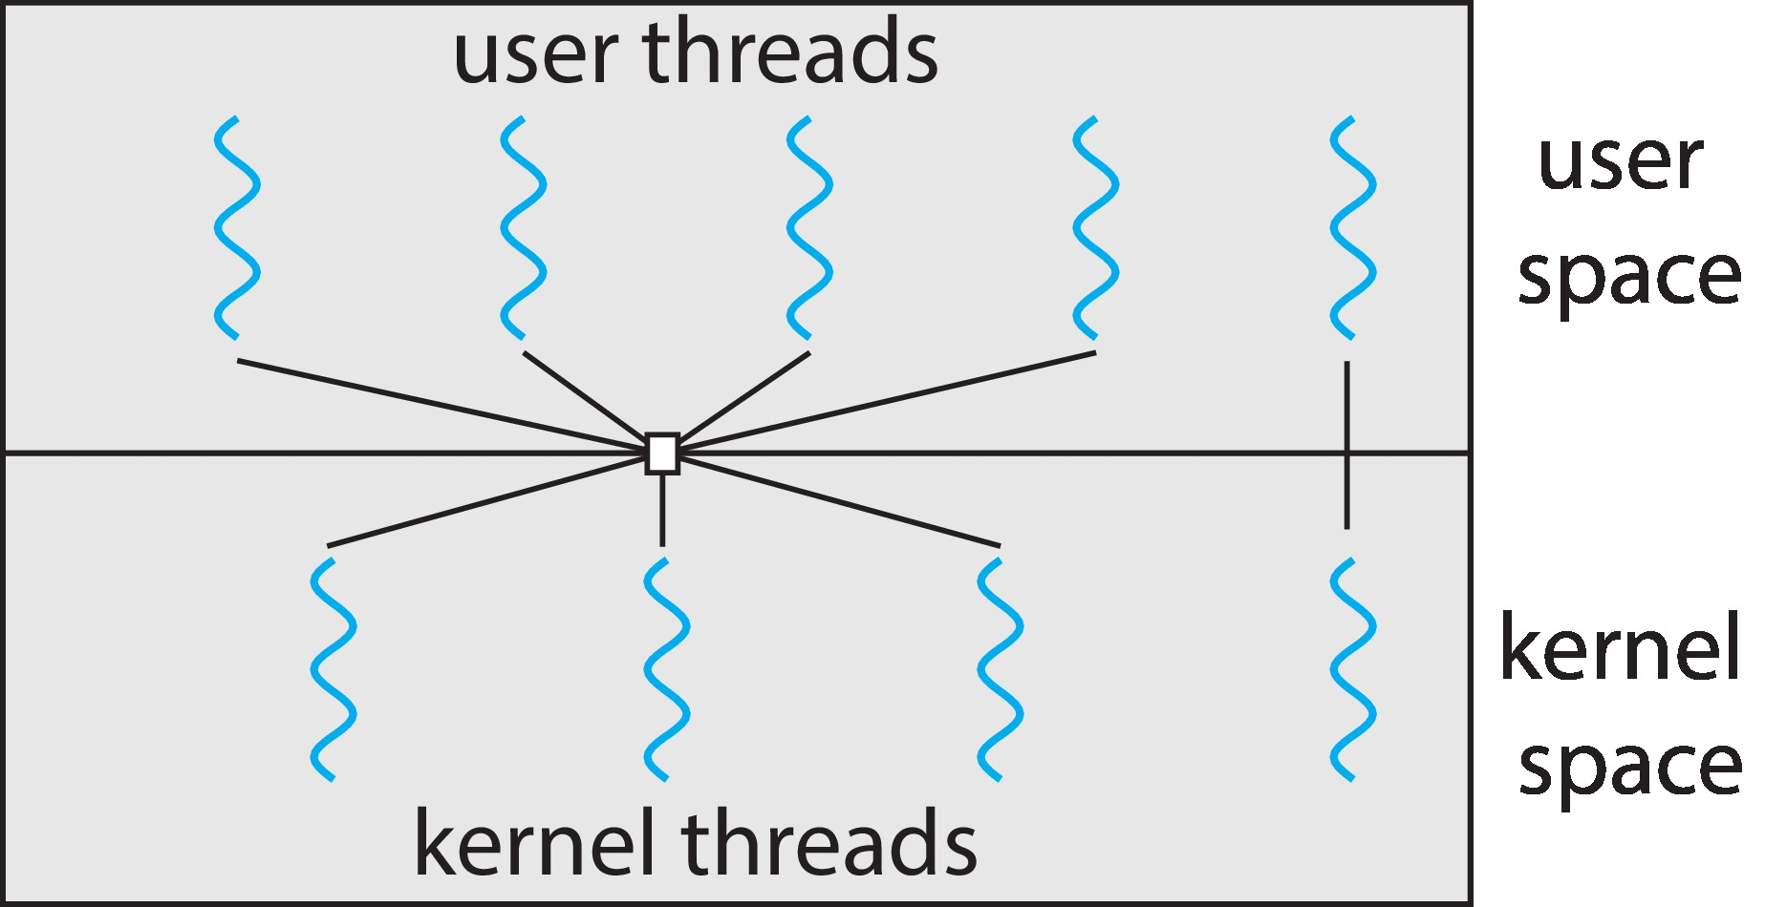
4.Two-level Model
Similar to M:M, except that it allows a user thread to be bound to kernel thread

Slide 22
Thread Libraries
Thread library provides programmer with API for creating and managing threads
Two primary ways of implementing
Library entirely in user space
Kernel-level library supported by the OS

Slide 23
Pthreads (POSIX THREAD)
May be provided either as user-level or kernel-level
A POSIX standard (IEEE 1003.1c) API for thread creation and synchronization
Specification, not implementation
API specifies behavior of the thread library, implementation is up to development of the library
Common in UNIX operating systems (Linux & Mac OS X)

Slide 24
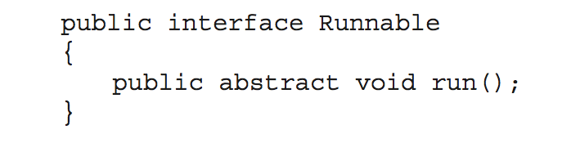
Java Threads
Java threads are managed by the JVM
Typically implemented using the threads model provided by underlying OS
Java threads may be created by:
Extending Thread class
Implementing the Runnable interface
Standard practice is to implement Runnable interface

Slide 25
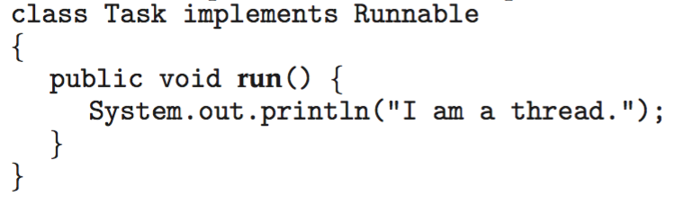
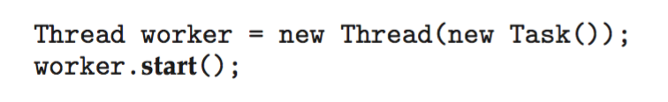
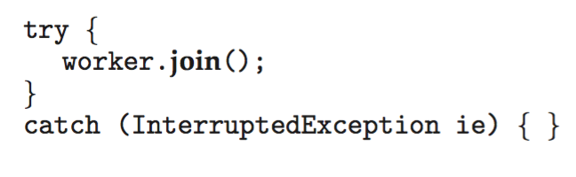
Java Threads
Implementing Runnable interface:
Creating a thread:
Waiting on a thread:

Slide 26
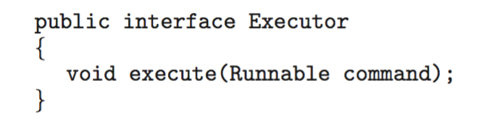
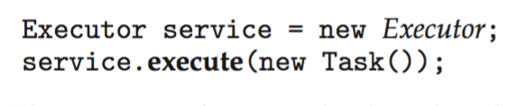
Java Executor Framework
Rather than explicitly creating threads, Java also allows thread creation around the Executor interface:
The Executor is used as follows:

Slide 27
4.5 Implicit Threading

Slide 28
Implicit Threading
Growing in popularity as numbers of threads increase, program correctness more difficult with explicit threads
The solution of these problems is to transfer the creation and management of threading from application developers to compilers and run-time libraries.
This strategy, termed implicit threading.
The advantage of this way is that developers only need to identify parallel tasks, and the libraries determine the specific details of thread creation and management.

Slide 29
Implicit Threading
Five methods explored
Thread Pools
Fork-Join
OpenMP
Grand Central Dispatch
Intel Threading Building Blocks

Slide 30
1.Thread Pools
Create a number of threads in a pool where they await work
Advantages:
Usually slightly faster to service a request with an existing thread than create a new thread
Allows the number of threads in the application(s) to be bound to the size of the pool
Separating task to be performed from mechanism of creating task allows different strategies for running task.
For example, the task could be scheduled to execute after a time delay or to execute periodically. يمكن جدولة المهمة للتنفيذ بعد تأخير زمني أو تنفيذها بشكل دوري

Slide 31
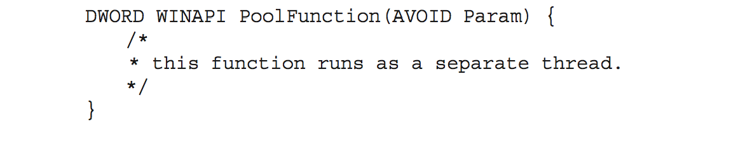
1.Thread Pools
Windows API supports thread pools:

Slide 32
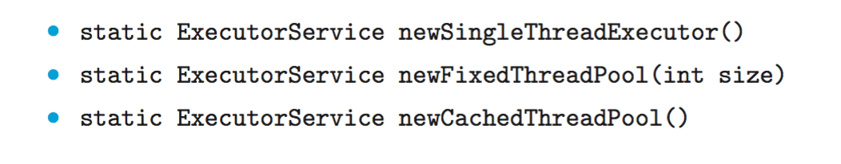
Java Thread Pools
Three factory methods for creating thread pools in Executors class:
Note: Cached thread pools will continue to create more and more threads in extreme

Slide 33
2. Fork-Join Parallelism
The main parent thread creates (forks) one or more child threads and then waits for the children to terminate and join with it, at which point it can retrieve and combine their results.
This synchronous model is often characterized as explicit thread creation, but it is also an excellent candidate for implicit threading.
In the latter situation, threads are not constructed directly during the fork stage; rather, parallel tasks are designated.

Slide 34
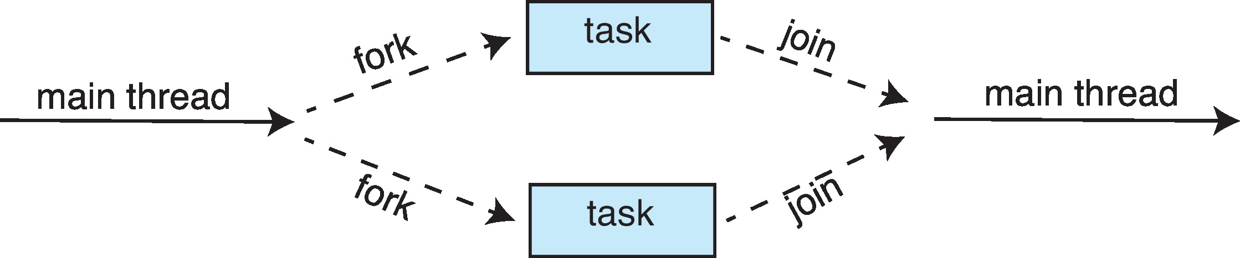
Fork-Join Parallelism
Multiple threads (tasks) are forked, and then joined.
A library manages the number of threads that are created and is also responsible for assigning tasks to threads.

Slide 35
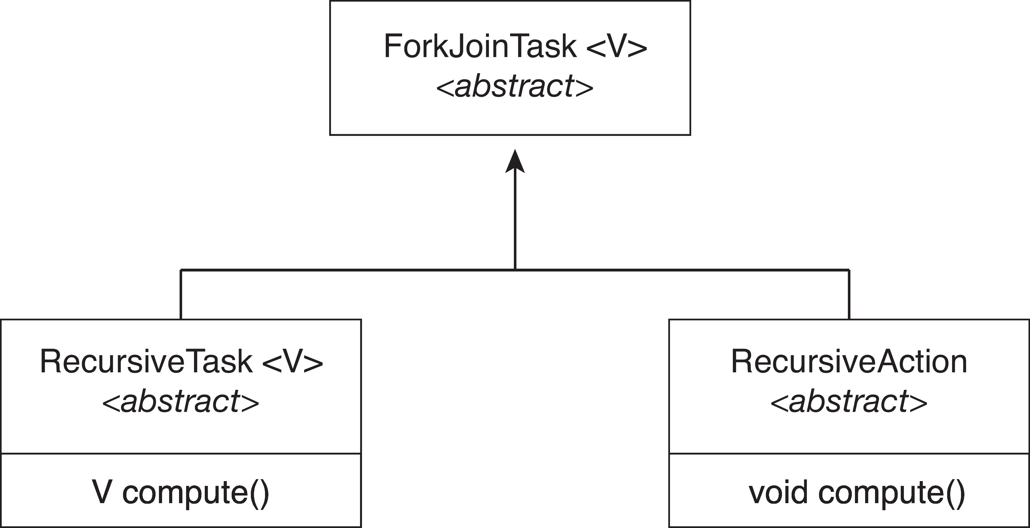
Fork-Join Parallelism in Java
The ForkJoinTask is an abstract base class
RecursiveTask and RecursiveAction classes extend ForkJoinTask
RecursiveTask returns a result (via the return value from the compute() method)
RecursiveAction does not return a result

Slide 36
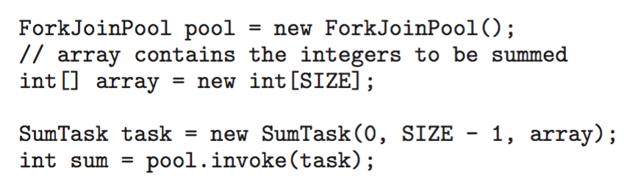
Fork-Join Parallelism in Java
In Version 1.7 of the API Java introduced a new thread pool— the ForkJoinPool— that can be assigned tasks that inherit the abstract base class ForkJoinTask (which for now we will assume is the SumTask class).
The following creates a ForkJoinPool object and submits the initial task via its invoke() method:

Slide 37
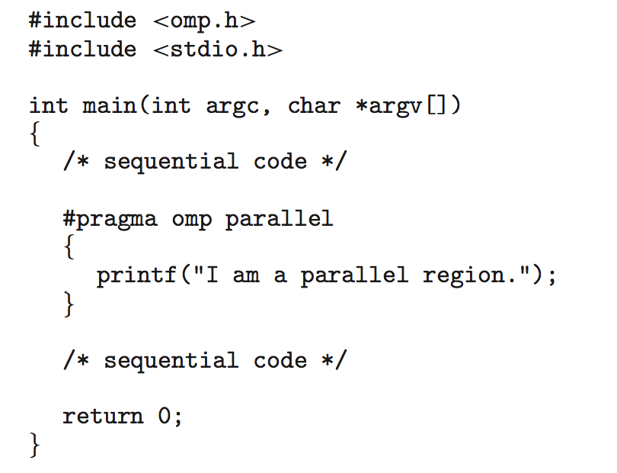
3.OpenMP (Open Multi-Processing)
Set of compiler directives and an API for C, C++, FORTRAN
Provides support for parallel programming in shared-memory environments
Identifies parallel regions – blocks of code that can run in parallel
#pragma omp parallel
Create as many threads as there are cores!
Notes:
OpenMP is a set of compiler directives as well as an API for programswritten in C, C++, or FORTRAN that provides support for parallel programming in sharedmemory
environments. OpenMP identifies parallel regions as blocks of code that may run in parallel. Application developers insert compiler directives into their code at parallel regions, and these directives instruct the OpenMP run

Slide 38
(Open Multi-Processing)
When OpenMP encounters the directive
#pragma omp parallel
it creates as many threads as there are processing cores in the system.
Thus, for a dual-core system, two threads are created; for a quad-core system, four are created; and so forth.
All the threads then simultaneously execute the parallel region. As each thread exits the parallel region, it is terminated.

Slide 39
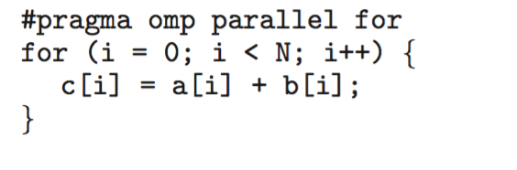
(#progma OMP parallel for)
OpenMP provides several additional directives for running code regions in parallel, including parallelizing loops.
For example, assume we have two arrays, a and b, of size N. We wish to sum their contents and place the results in array c. We can have this task run in parallel by using the following code segment, which contains the compiler directive for parallelizing for loops:
Run the for loop in parallel تجزئ الدوران حسب عدد المعالجات
OpenMP divides the work contained in the for loop among the threads it has created in response to the directive
#pragma omp parallel for

Slide 40
4.5.4 Grand Central Dispatch
Apple technology for macOS and iOS operating systems
Extensions to C, C++ and Objective-C languages, API, and run-time library
Allows identification of parallel sections
Manages most of the details of threading
Block is in “^{ }” : ˆ{ printf("I am a block"); }
Blocks placed in dispatch queue
Assigned to available thread in thread pool when removed from queue

Slide 41
Grand Central Dispatch
Two types of dispatch queues:
serial – blocks removed in FIFO order, queue is per process, called main queue
Programmers can create additional serial queues within program
concurrent – removed in FIFO order but several may be removed at a time
Four system wide queues divided by quality of service:
QOS_CLASS_USER_INTERACTIVE
QOS_CLASS_USER_INITIATED
QOS_CLASS_USER_UTILITY
QOS_CLASS_USER_BACKGROUND

Slide 42
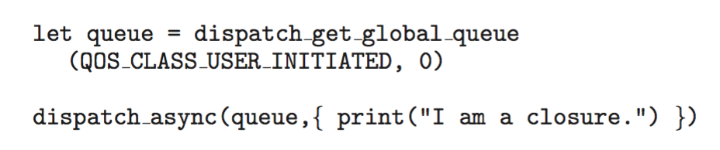
Grand Central Dispatch
For the Swift language a task is defined as a closure – similar to a block, minus the caret
Closures are submitted to the queue using theيتم إرسال عمليات الإغلاق إلى قائمة الانتظار باستخدام dispatch_async() function:
Notes:
Welcome to the Swift community. Together we are working to build a programming language to empower everyone to turn their ideas into apps on any platform.
Announced in 2014, the Swift programming language has quickly become one of the fastest growing languages in history. Swift makes it easy to write software that is incredibly fast and safe by design. Our goals for Swift are ambitious: we want to make programming simple things easy, and difficult things possible.
For students, learning Swift has been a great introduction to modern programming concepts and best practices. And because it is open, their Swift skills will be able to be applied to an even broader range of platforms, from mobile devices to the desktop to the cloud.

Slide 43
5.Intel Threading Building Blocks (TBB)
Intel threading building blocks (TBB) is a template library that supports designing parallel applications in C++.
As this is a library, it requires no special compiler or language support.
Developers specify tasks that can run in parallel, and the TBB task scheduler maps these tasks onto underlying threads.
Furthermore, the task scheduler provides load balancing and is cache aware, meaning that it will give precedence to tasks that likely have their data stored in cache memory and thus will execute more quickly. مما يعني أنه سيعطي الأسبقية للمهام التي من المحتمل أن تكون بياناتها مخزنة في ذاكرة التخزين المؤقت
TBB provides a rich set of features:
templates for parallel loop structures,
atomic operations,
mutual exclusion locking.
concurrent data structures,
including a hash map, queue, and vector, which can serve as equivalent thread-safe versions of the C++ standard template library data structures.

Slide 44
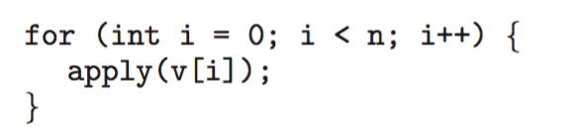
5.Intel Threading Building Blocks (TBB)
Let’s use parallel for loops as an example.
Initially, assume there is a function named apply(float value) that performs an operation on the parameter value.
If we had an array v of size n containing float values, we could use the following serial for loop to pass each value in v to the apply() function:
A serial version of a simple for loop
The same for loop written using TBB with parallel_for statement:
parallel for (range body )

Slide 45
TBB
The TBB library will divide the loop iterations into separate “chunks” and create a number of tasks that operate on those chunks.
TBB will also create a number of threads and assign tasks to available threads. This is quite similar to the fork-join library in Java.
The advantage of this approach is that it requires only that developers identify what operations can run in parallel (by specifying a parallel for loop), and the library manages the details involved in dividing the work into separate tasks that run in parallel.
Intel TBB has both commercial and open-source versions that run on Windows, Linux, and macOS.

Slide 46
Threading Issues
Semantics of fork() and exec() system calls
Signal handling
Synchronous and asynchronous
Thread cancellation of target thread
Asynchronous or deferred
Thread-local storage
Scheduler Activations

Slide 47
Semantics of fork() and exec()
Does fork()duplicate only the calling thread or all threads?
Some UNIXes have two versions of fork
exec() usually works as normal – replace the running process including all threads

Slide 48
Signal Handling
Signals are used in UNIX systems to notify a process that a particular event has occurred.
A signal handler is used to process signals
Signal is generated by particular event
Signal is delivered to a process
Signal is handled by one of two signal handlers:
default
user-defined
Every signal has default handler that kernel runs when handling signal
User-defined signal handler can override default
For single-threaded, signal delivered to process

Slide 49
Signal Handling (Cont.)
Where should a signal be delivered for multi-threaded?
Deliver the signal to the thread to which the signal appliesقم بتوصيل الإشارة إلى البرنامج الفرعي الذي تنطبق عليه الإشارة
Deliver the signal to every thread in the processقم بتوصيل الإشارة إلى كل برنامج فرعي في بالبرنامج
Deliver the signal to certain threads in the processقم بتوصيل الإشارة إلى برامج فرعيه معينة في العملية
Assign a specific thread to receive all signals for the processقم بتعيين برنامج فرعي معين لتلقي جميع الإشارات للعملية

Slide 50
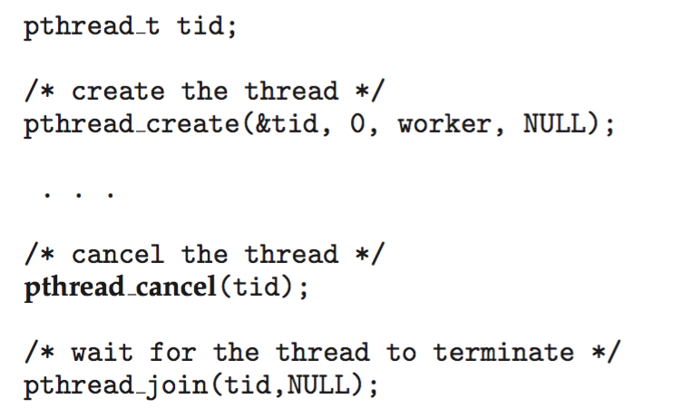
Thread Cancellation
Terminating a thread before it has finished
Thread to be canceled is target thread
Two general approaches:
Asynchronous cancellation terminates the target thread immediately
Deferred cancellation allows the target thread to periodically check if it should be cancelled
Pthread code to create and cancel a thread:

Slide 51
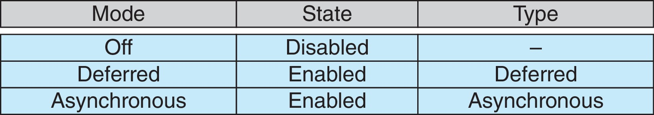
Thread Cancellation (Cont.)
Invoking thread cancellation requests cancellation, but actual cancellation depends on thread state
If thread has cancellation disabled, cancellation remains pending until thread enables it
Default type is deferred
Cancellation only occurs when thread reaches cancellation point
i.e., pthread_testcancel()
Then cleanup handler is invoked
On Linux systems, thread cancellation is handled through signals

Slide 52
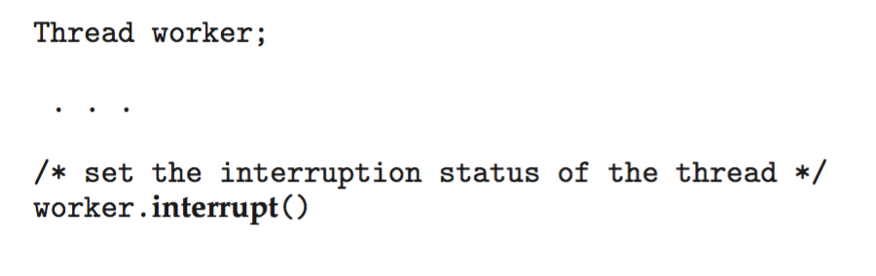
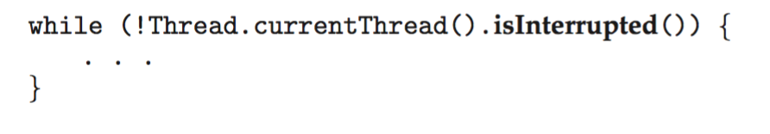
Thread Cancellation in Java
Deferred cancellation uses the interrupt() method, which sets the interrupted status of a thread.
A thread can then check to see if it has been interrupted:

Slide 53
Thread-Local Storage
Thread-local storage (TLS) allows each thread to have its own copy of data
Useful when you do not have control over the thread creation process (i.e., when using a thread pool)
Different from local variables
Local variables visible only during single function invocation
TLS visible across function invocationsاستدعاءات
Similar to static data
TLS is unique to each thread

Slide 54
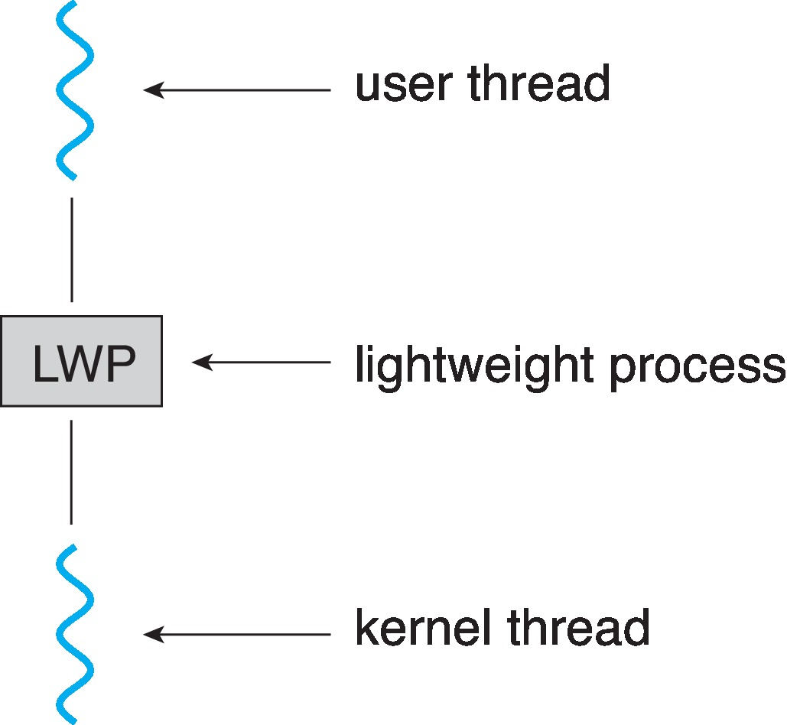
Scheduler Activations
Both M:M and Two-level models require communication to maintain the appropriate number of kernel threads allocated to the application
Typically use an intermediate data structure between user and kernel threads – lightweight process (LWP)
Appears to be a virtual processor on which process can schedule user thread to run
Each LWP attached to kernel thread
How many LWPs to create?
Scheduler activations provide upcalls - a communication mechanism from the kernel to the upcall handler in the thread library
This communication allows an application to maintain the correct number kernel threads

Slide 55
Operating System Examples
Windows Threads
Linux Threads
Notes:
55

Slide 56
Windows Threads
Windows API – primary API for Windows applications
Implements the one-to-one mapping, kernel-level
Each thread contains
A thread id
Register set representing state of processor
Separate user and kernel stacks for when thread runs in user mode or kernel mode
Private data storage area used by run-time libraries and dynamic link libraries (DLLs)
The register set, stacks, and private storage area are known as the context of the thread

Slide 57
Windows Threads (Cont.)
The primary data structures of a thread include:
ETHREAD (executive thread block) – includes pointer to process to which thread belongs and to KTHREAD, in kernel space
KTHREAD (kernel thread block) – scheduling and synchronization info, kernel-mode stack, pointer to TEB, in kernel space
TEB (thread environment block) – thread id, user-mode stack, thread-local storage, in user space

Slide 58
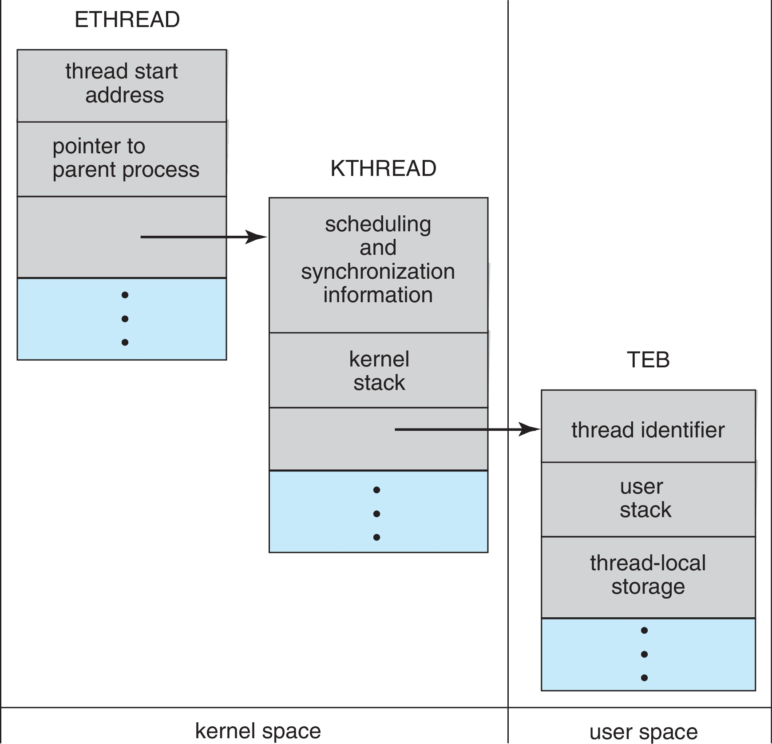
Windows Threads Data Structures

Slide 59
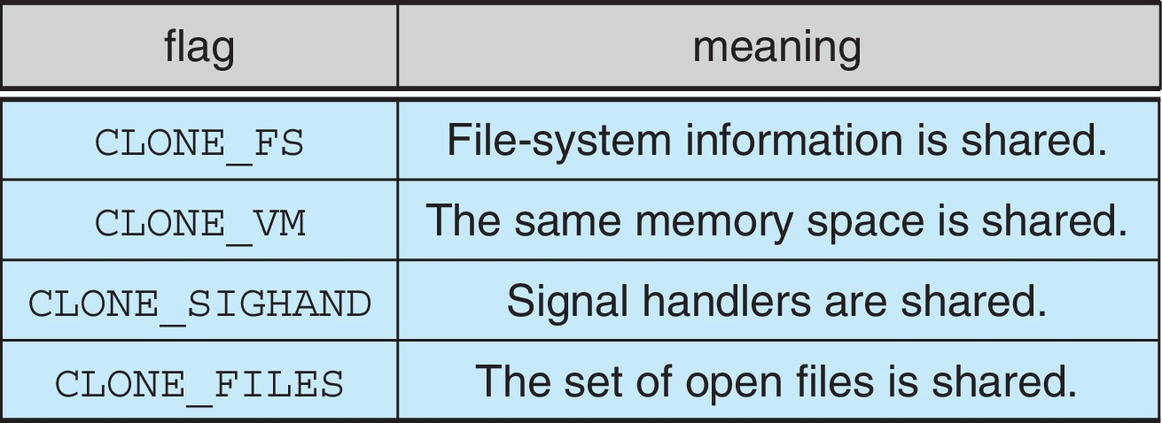
Linux Threads
Linux refers to them as tasks rather than threads
Thread creation is done through clone() system call
clone() allows a child task to share the address space of the parent task (process)
Flags control behavior
struct task_struct points to process data structures (shared or unique)

Slide 60
End of Chapter 4

